Slide 1









IEEE SSH 2024
HACKATHON
KATHON

Slide 2
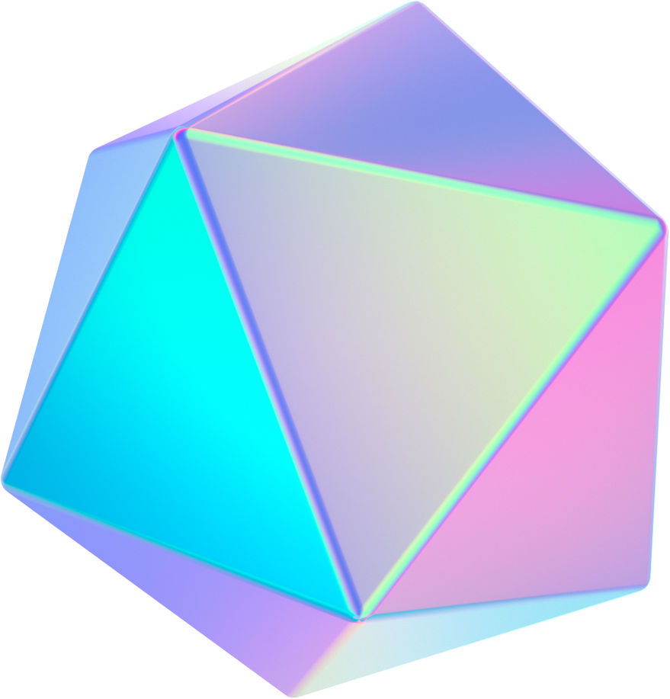


Team name: NEURO 404
Team Members name:
TEAM LEADER - DIGEESH P C MEMBER 2- DHARSHINI M
MENBER 3- AJIN RIBIA P

Slide 3


Problem statement :
TRACK : EDUCATION
Smart Education Tool :
VR-Based Interactive
Learning for Children with ASD and ID.

Slide 4

Solutions
Tailored Learning: Safe space for practicing and reinforcing social interactions .
Progress Tracking: Dashboard for monitoring progress and adapting learning .
VR Sensory Adaption: Customizable Settings with Iterative Testing.

Slide 5

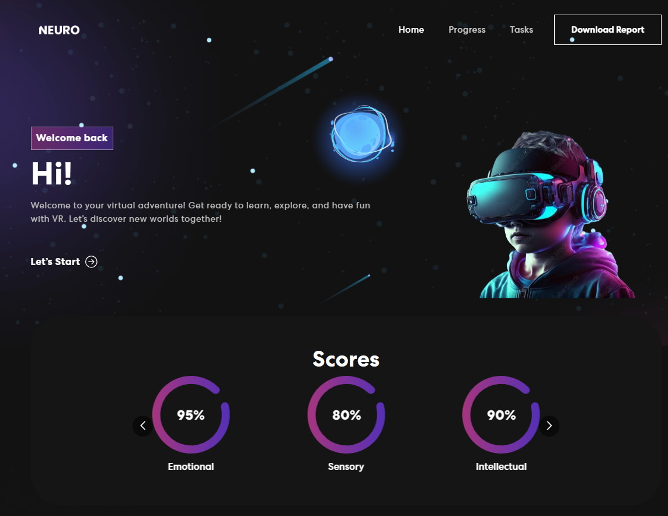

USP
Our VR tool supports up to 100 users at once, allowing simultaneous access for children, parents, and educators.
New scenarios and features can be added regularly, ensuring the platform stays engaging.
Immersive Learning
Personalized Development
Progress Monitoring in our dashboard.

Slide 6


Tech Stack
FRONT END
React.js
Three.js
Bootstrap
Material-UI
BACK END
Node.js
Express.js
MongoDB
TensorFlow.js
CLOUD SERVICE
AWS
VR
Unity
Blender
WebXR API

Slide 7
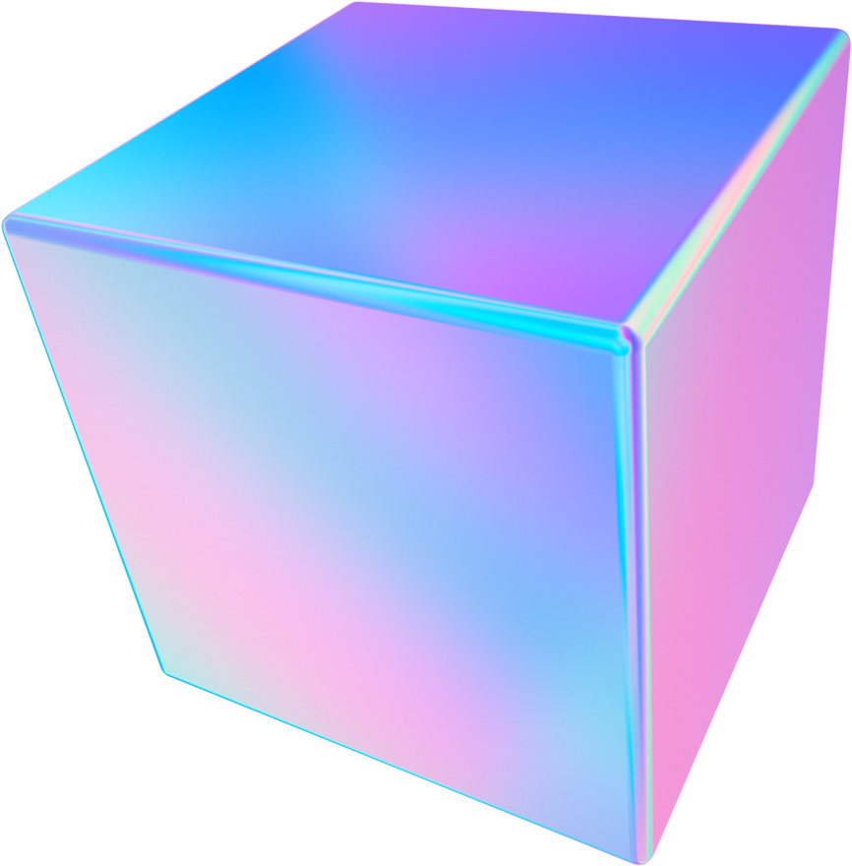
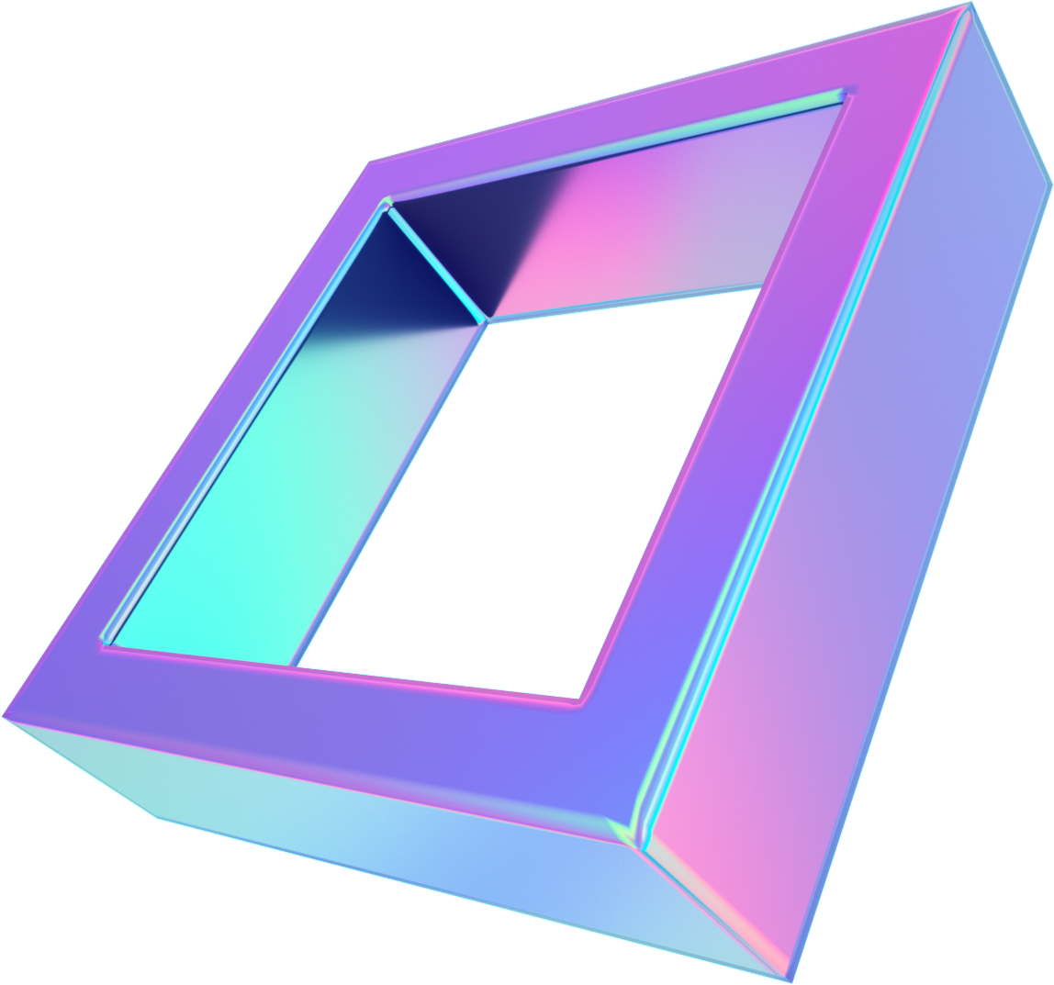
Future Aspects
Safe VR for practising social skills.
Improves emotional recognition and social confidence.
VR can help children with ASD learn to be safe and aware of alarm situations.
VR can help children with ASD improve their language function and communication skills.

Slide 8
Thank You

